Slide 1
Integrated water resources management
Upper Mississippi River Perspective
COL Bryan Sizemore
St. Louis District Commander
Upper Mississippi River Conference
25 October 2018

Slide 2
USACE GLOBALLY RESPONSIVE
110+ Countries Supported
34,000 Civilian Personnel
700 Military Personnel
9 Divisions
43 Districts
9 Centers & Labs
1 Active Duty Unit

Slide 3
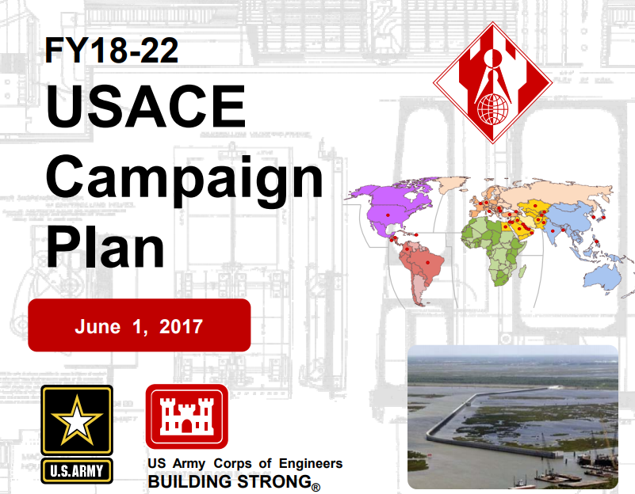
USACE Campaign Plan FY18-22
4 GOALS:
Support National Security
Deliver Integrated Water Resource Solutions
Reduce Disaster Risks
Prepare for Tomorrow

Slide 4
MISSISSIPPI VALLEY DIVISION
Largest watershed in North America
3rd largest watershed in the world
37,000 squares
12 states
6 Districts, defined by river basins.
MN
MI
WI
MINNEAPOLIS
ST. PAUL
IA
ROCK ISLAND
IL
ST. LOUIS
MO
CAIRO
MEMPHIS
LITTLE ROCK
VICKSBURG
LA
NEW ORLEANS

Slide 5
Integrated Water Resources Management
Regulations/ Policy
Cultural Resources
Geography
Combines all aspects of planning, development, management of water, land, and related resources
System wide approach
Collaboration and Partnering
Risk-Informed Decision Making & Communication Technology
Supported at all levels – local, state, tribal, federal
Landowners
The Public
Federal Agencies
Native American Groups
Human Systems
Social
Economic
State Agencies
Local & Regional Government
Environmental
IWRM

Slide 6
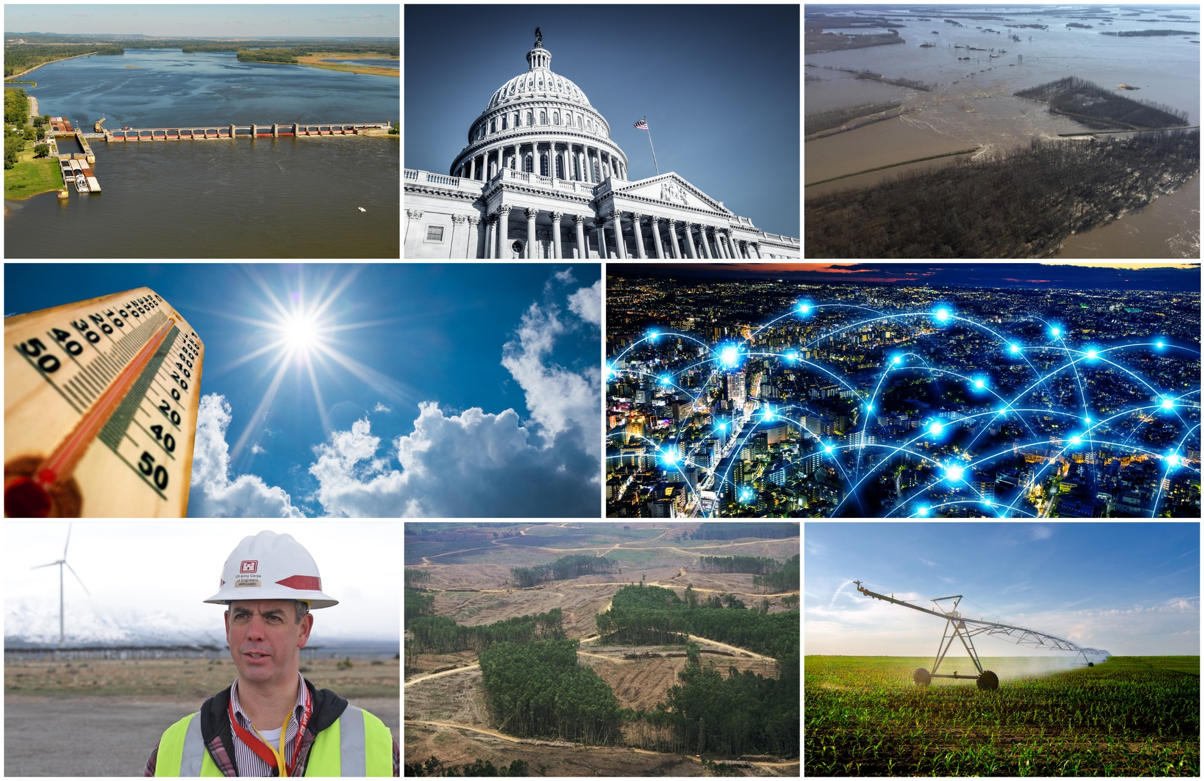
National Water Resource Challenges

Slide 7
Path Forward
Apply USACE resources toward the highest priority regional needs
Increase regional prediction of future water resources needs through partnership
Deliver products and solutions that address the critical watershed challenges
River Forecasting and Water Management
Hydraulic Modeling
Watershed Study
Silver Jackets Program
Upper Mississippi River Restoration Program
Navigation Ecosystem Sustainability Program

Slide 8
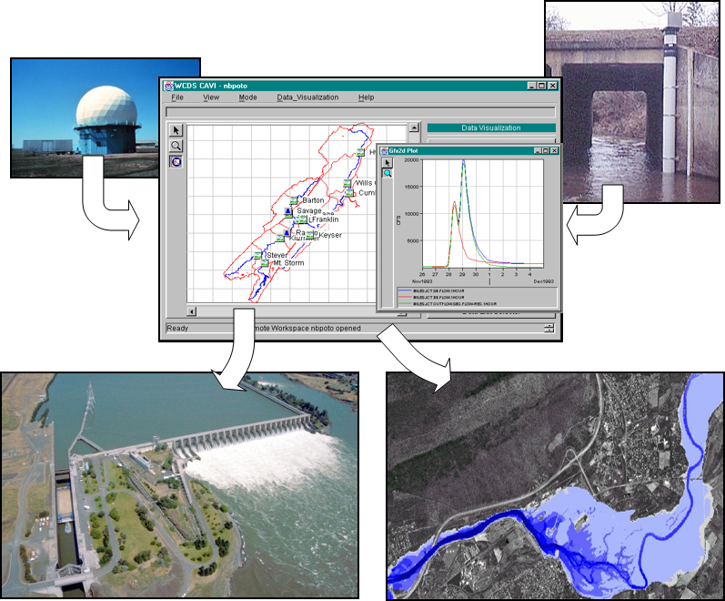
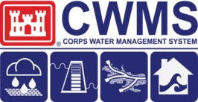
River Forecasting & Water Management
Fusion Team
Corps Water Management System (CWMS)

Slide 9
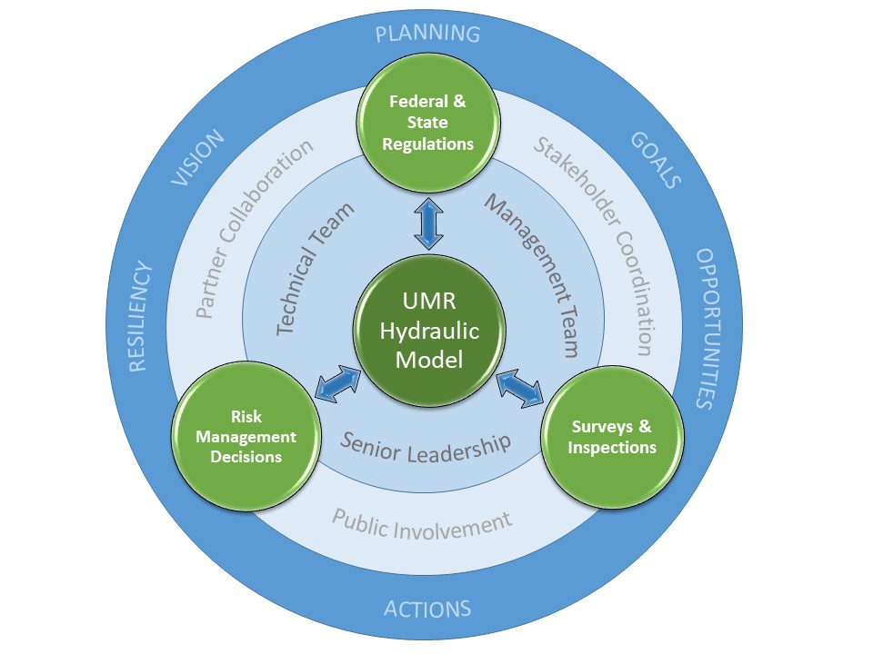
UPPER MISSISSIPPI River Flood Risk Management HYDRAULIC MODEL

Slide 10
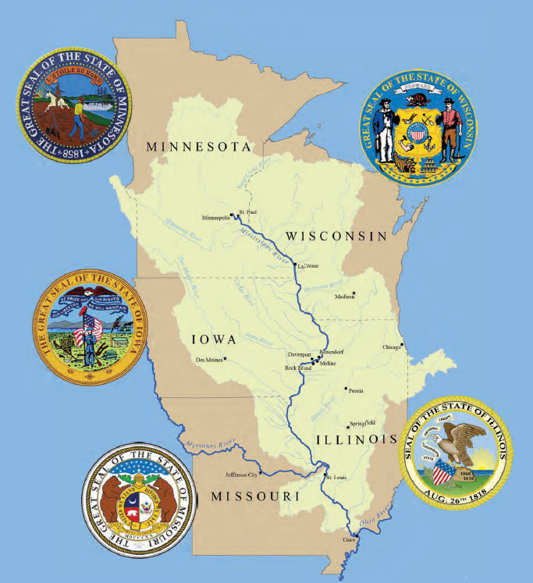
UMR FLOOD RISK & SEDIMENT MANAGEMENT
Vision
Challenges
Goals

Slide 11
Silver Jackets Interagency FRM Efforts
Facilitate strategic life-cycle flood risk reduction.
Create or supplement a continuous mechanism to collaboratively solve state-prioritized issues and implement or recommend those solutions.
Improve processes, identifying and resolving gaps and counteractive programs.
Leverage and optimize resources.
Improve and increase flood risk communication and present a unified interagency message.
Establish close relationships to facilitate integrated post-disaster recovery solutions.
No single agency has all the answers, but leveraging multiple programs and perspectives can provide a cohesive solution.

Slide 12
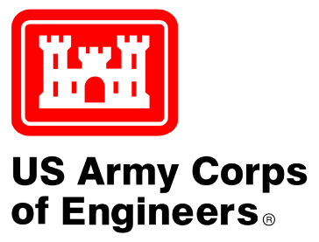
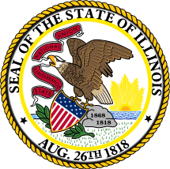
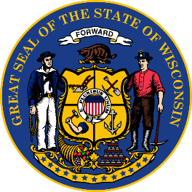
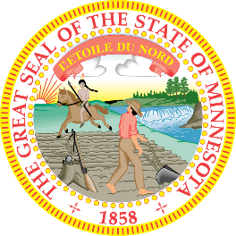
UPPER MISSISSIPPI RIVER RESTORATION (UMRR)

Slide 13
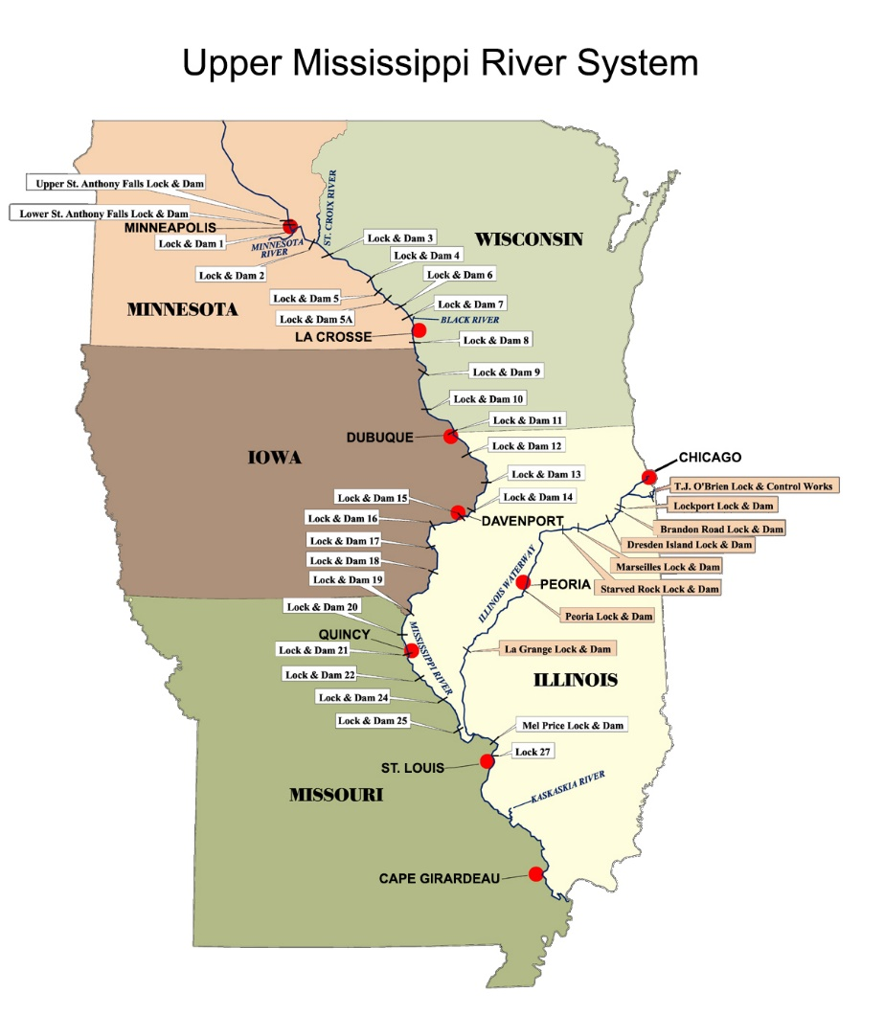
NAVIGATION AND ECOSYSTEM SUSTAINABILITY PROGRAM
Indicates New Lock Chamber

Slide 14
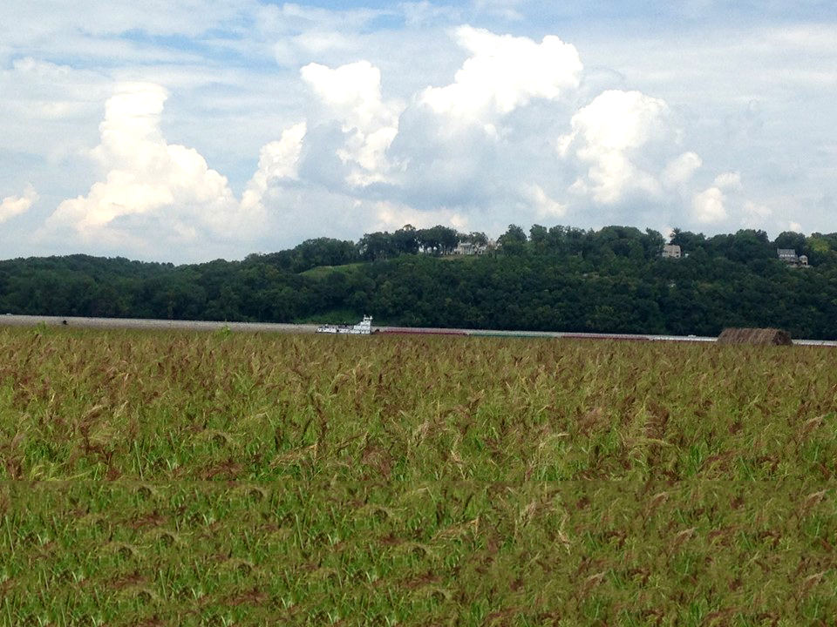
It’s about balance
Quality Environment
Quality of Life
Engineer Sustainable Development
Sound Stewardship
Strategic Collaboration
Economic Development

Slide 15
THANK YOU

